Slide 1
IRIS FLOWER
CLASSIFICATION
Presented by: Tahezeeb Jaweed Peerji | Domain: AI/ML | Week: 4
From flower measurements → species prediction
ANN / MLP Classifier • 150 samples • 4 features

Slide 2
1. Project Objective
Problem
Predict the species of an Iris flower using four measured features.
Target classes
Iris setosa
Iris versicolor
Iris virginica
02

Slide 3
2. Dataset & Features
150
4
3
80 / 20
samples
features
classes
train / test
Sepal Length
measured in cm
Sepal Width
measured in cm
Petal Length
measured in cm
Petal Width
measured in cm
03

Slide 4
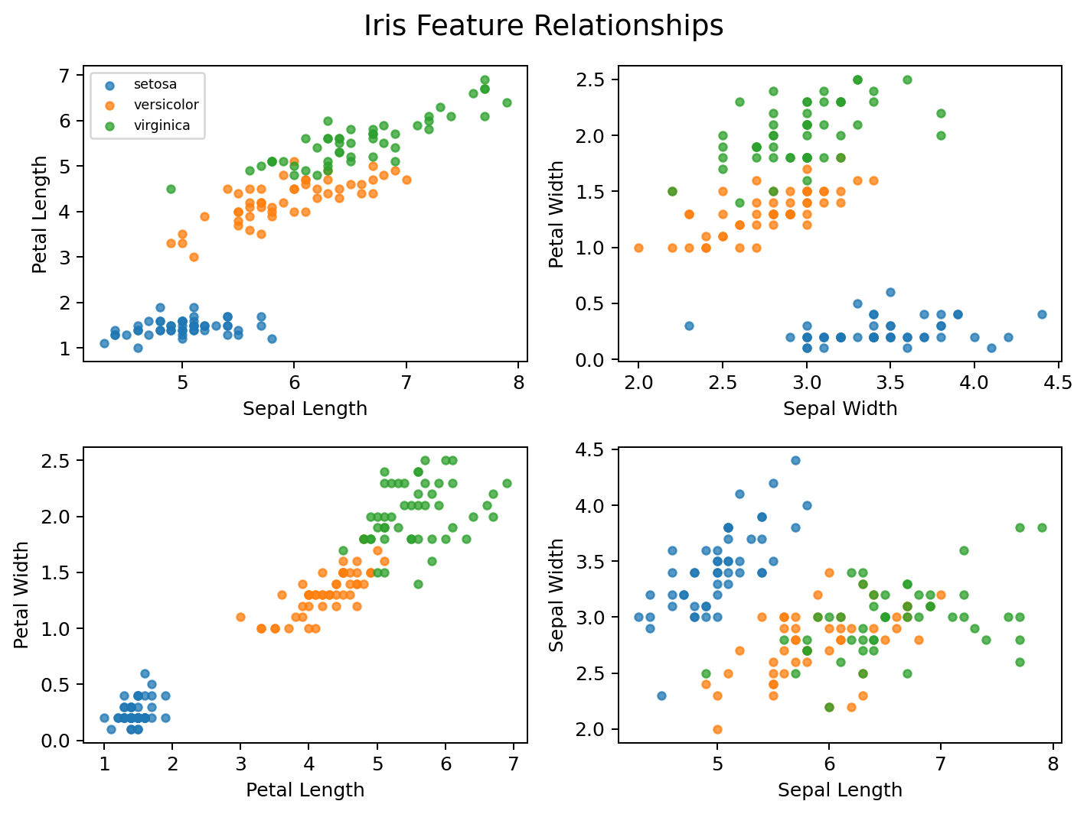
3. Exploratory Data Analysis
Notebook checks
✓ Missing values
✓ Class distribution
✓ Pairwise feature relationships
✓ Visual separation of species
04

Slide 5
4. Data Preparation
01
02
03
04
Split
Stratify
Scale
Transform
80% training
20% testing
Keep class balance
Standard Scaler
Apply same scaler to test data
Scaling is important because the neural network learns from numerical feature values.
05

Slide 6
5. Model: Artificial Neural Network (MLP)
Hidden 1
Hidden 2
Inputs
Output
→
→
→
8
4
3
16
Architecture
4 inputs → 16 neurons → 8 neurons → 3 classes
06

Slide 7
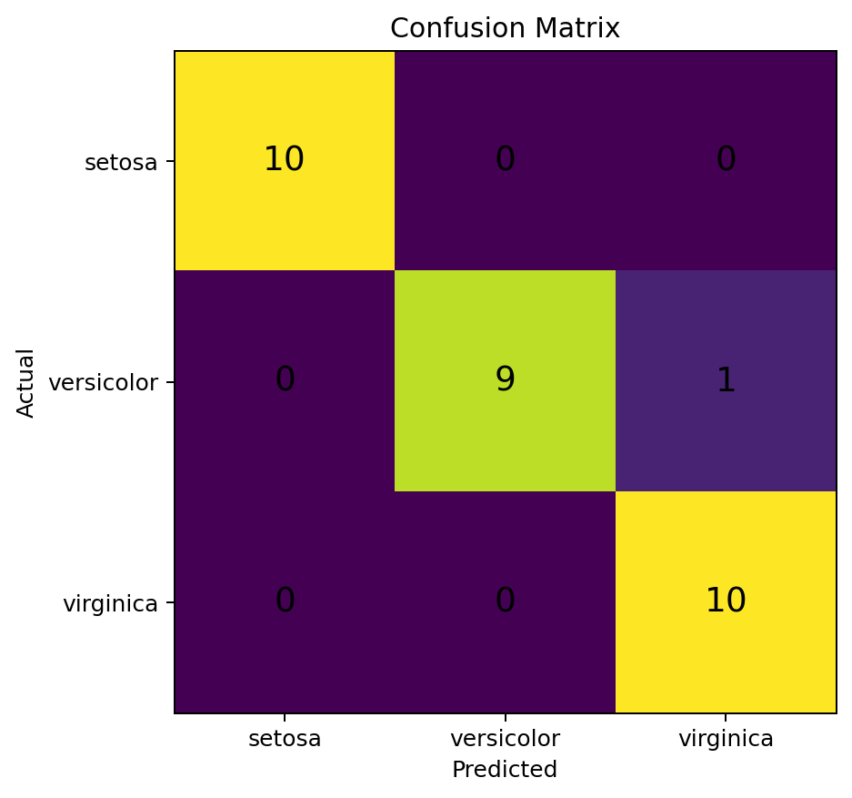
6. Model Performance
96.67%
TEST ACCURACY
29 of 30 test samples classified correctly.
Test set = 30 samples
07

Slide 8
7. Classification Report
Class
Precision
Recall
F1-score
Support
Class
Precision
Recall
F1-score
Support
setosa
1.00
1.00
1.00
10
versicolor
1.00
0.90
0.95
10
virginica
0.91
1.00
0.95
10
Overall:
Accuracy 0.97 • Macro F1 0.97 • Weighted F1 0.97
08

Slide 9
8. New Flower Prediction
Single prediction
Multiple predictions
[5.1, 3.5, 1.4, 0.2]
Flower 1 → setosa
↓ Standard Scaler ↓
Flower 2 → versicolor
Predicted Species
Flower 3 → virginica
IRIS SETOSA
09

Slide 10
9. CONCLUSION
1
Four flower measurements are used as model inputs.
2
The ANN/MLP learns patterns from the training data.
3
Standardization prepares the numerical features.
4
The reproduced test accuracy is 96.67%.
5
The trained model can predict new Iris flowers.
THANK YOU
10

